Slide 1

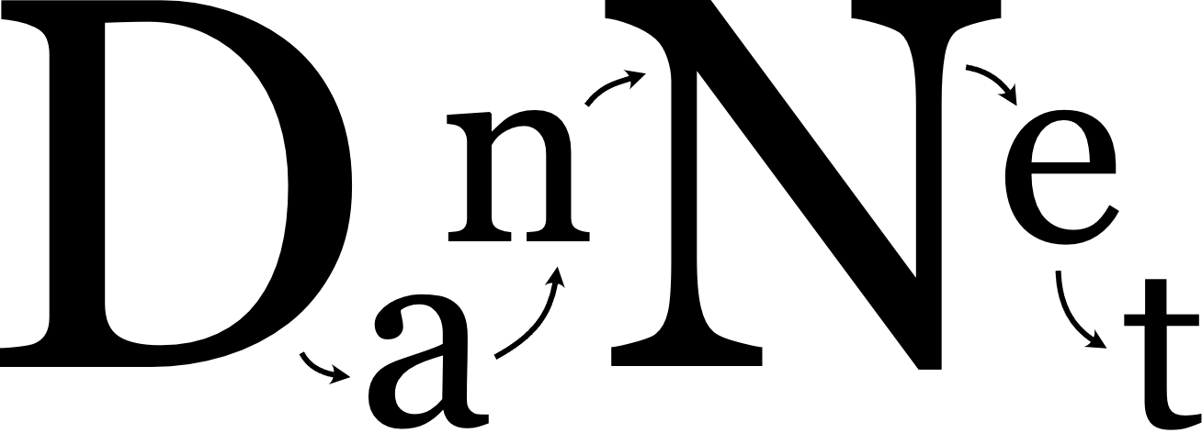
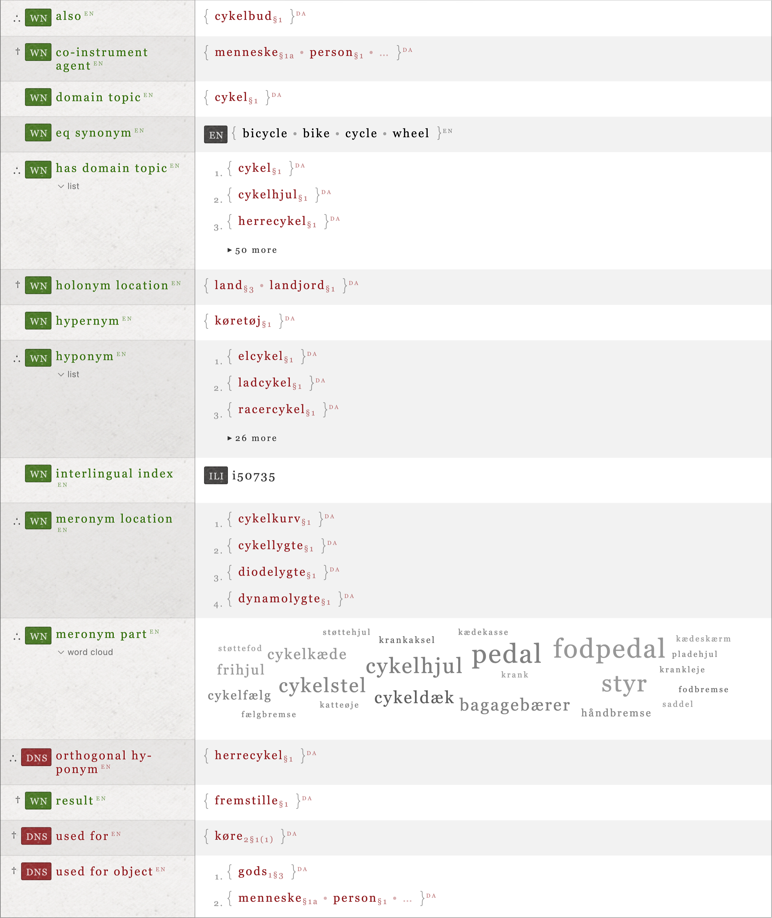
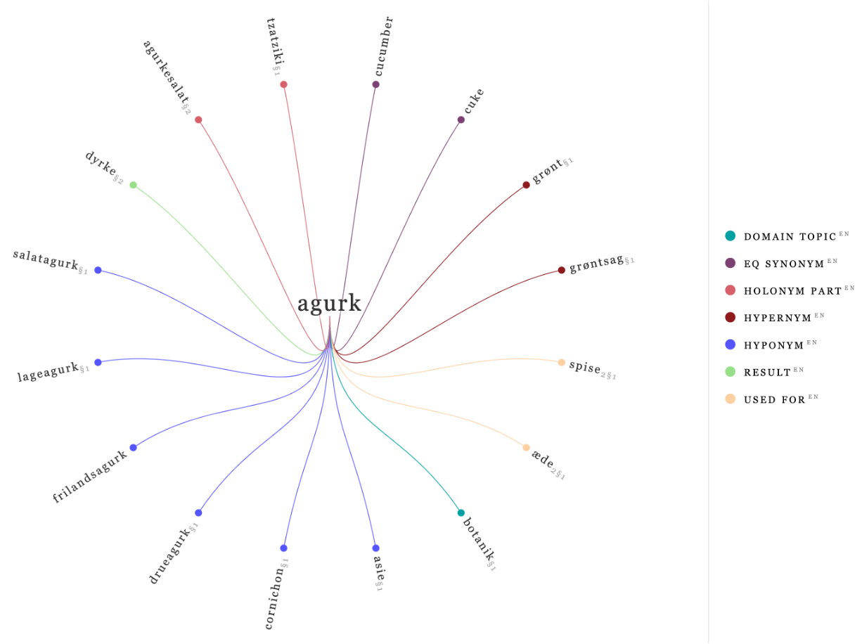
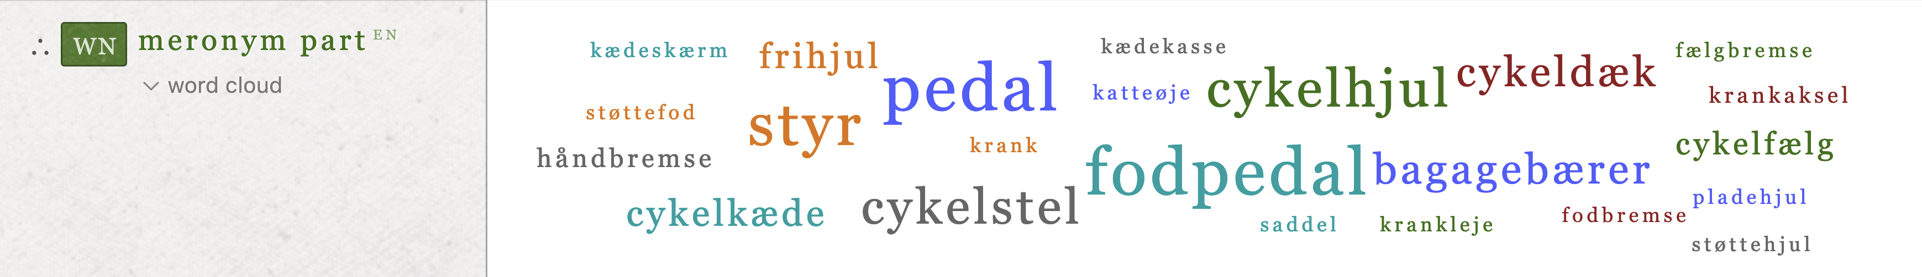
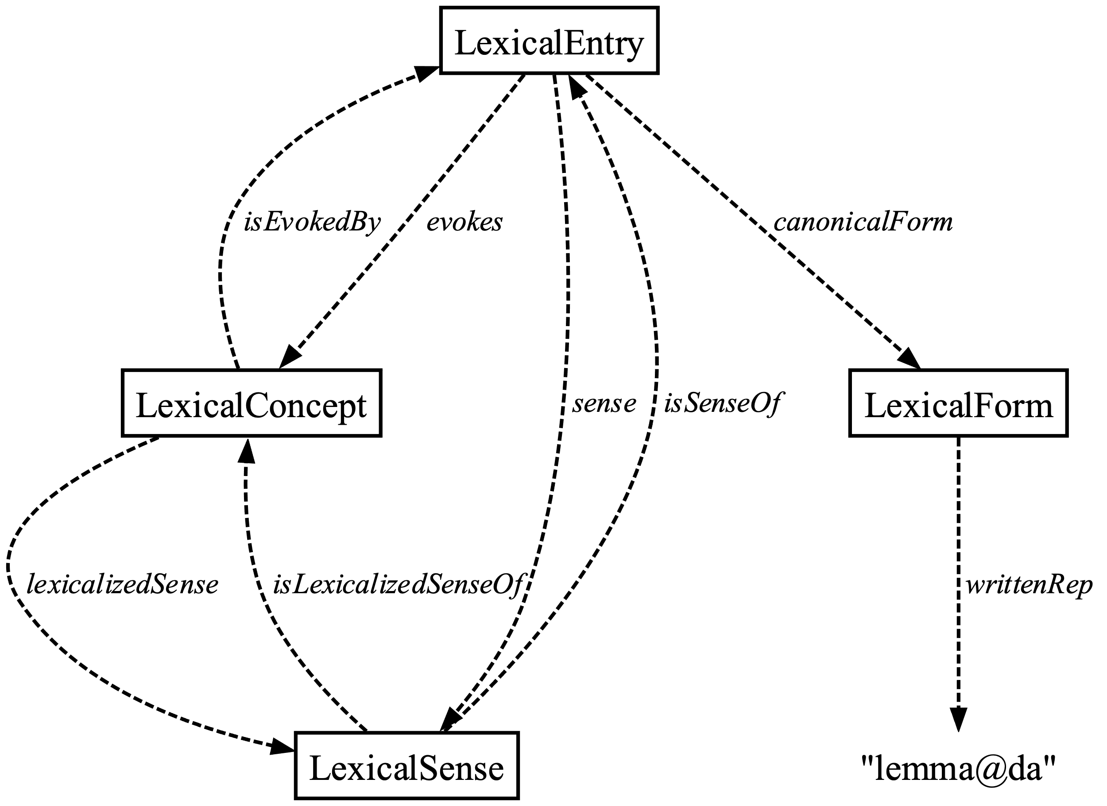
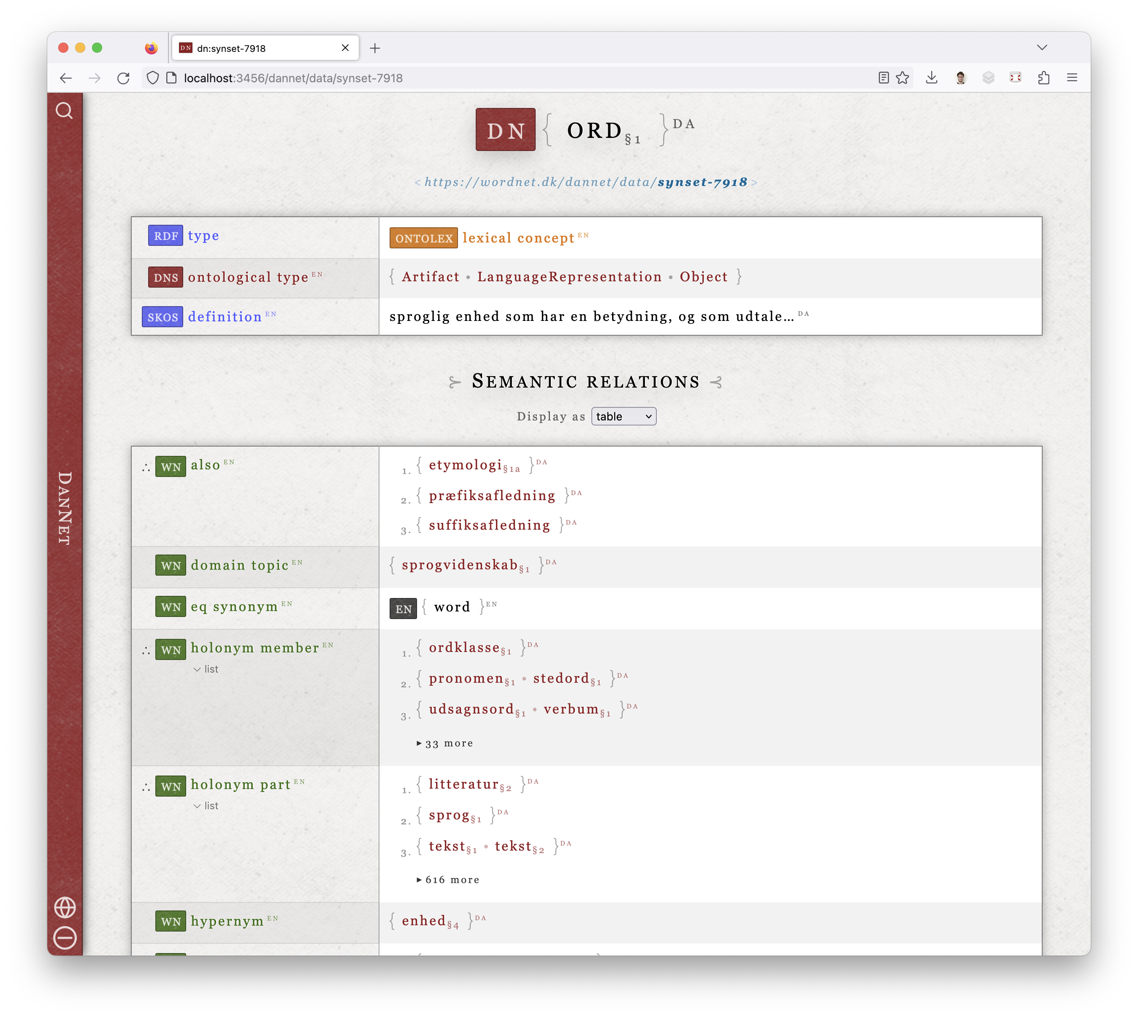
The new
University of copenhagen
Department of Nordic StudieS & Lingustics
Centre for Language Technology
A bit of history
DanNet was originally released in 2009. It has been maintained and extended until today with the help of funding from many different sources.
The original paper ⁶ introducing DanNet details how it originally came about as a resource derived from Den Danske Ordbog (ordnet.dk/ddo) inspired by concepts taken from the EuroWordNet ⁷ project. More information may be found in the cited papers and at:
cst.ku.dk/projekter/dannet
This latest release has been funded by Carlsberg Fondets infrastrukturpulje, DSL, and UCPH. Until now, the technical side of DanNet has been maintained by DSL, but as of the 2023 release the stewardship now lies with the Centre for Language Technology (NorS, UCPH).
DanNet, the Danish WordNet, is a semantic language resource that links the many words of the Danish language in various ways.
In 2023, an entirely new version of DanNet was released, containing major changes along with a new web presence at wordnet.dk/dannet.
The project is a collaborative effort of Det Danske Sprog- og Litteraturselskab and the Centre for Language Technology: Ida Flörke, Simon Gray, Jonas Jensen, Sanni Nimb, Ida Rørmann Olsen, Sussi Olsen, Bolette Sandford Pedersen, Nicolai H. Sørensen, and Thomas Troelsgård have all contributed.
About WordNets
A WordNet is a lexico-semantic network graph which shows how the concepts of a language relate to other concepts through semantic relations. One can also think of a WordNet as a kind of machine-readable dictionary.
Unlike a typical dictionary, definitions aren't central. Instead, the relations between words (grouped by sets of synonyms — or synsets) are key. For example, you can see that a Swiss willow is a kind of bush, that a gazebo is located in a garden, that "fiberdrys" is for eating, and that cakes are typically produced by baking and usually made from flour and sugar.
DanNet currently contains ~70,000 concepts (synsets) connected by ~500,000 semantic relations.
New additions
The DanNet dataset has been expanded and many dataset inconsistencies or other undesirable properties have been cleaned up. Furthermore,
An additional ~5000 new concepts have been added, mostly adjectives. ¹
An additional ~5000 new links between DanNet and the Open English WordNet (OEWN), or via the Collaborative Interlingual Index (CILI).²
Most words and senses have been linked to "Den Danske Ordbog" (DDO) via our new dns:source relation, i.e. links to entries on ordnet.dk/ddo.
RDF vs. tables
DanNet and other WordNets have long been published as RDF. However, in DanNet's case, the RDF/XML serialisation had primarily been used as a method of distribution to third parties, while internally the DanNet graph had been modelled as tables within a traditional SQL database. These two models were only connected in a limited fashion, requiring adapter code.
While using a more widespread data model such as the relational model has clear benefits, combining it with graphs is not as ergonomic due to the differing perspectives of the two data models. The semantic web stack (RDF, SPARQL, …) is a better fit. It is quite mature after several decades of standards development.
Dynamic inline visualisations Individual one-to-many relations can be visualised in place, e.g. as an interactive word cloud (above: bicycle parts).
The labels used in DanNet have also been greatly revised. The part of the label denoting the section of DDO where a sense may originally have been pulled from is now clearly marked using the same format as DDO, e.g. the sense label of the synset { øvrighed_{§1a} } is also to be found in section 1.a of the corresponding entry on the DDO website (ordnet.dk/ddo).
The longest synset labels now also come with abbreviated dns:shortLabel versions which contain only the most canonical words of the synset. The new website can switch on-demand between full and abbreviated labels.
Serialised graphs
The decision to go RDF-native was based on some of these thoughts:
WordNets are simply network graphs.
Graphs can be decomposed into triplets.
RDF is a graph abstraction using triplets as its fundamental data structure.
The optimal data representation for DanNet allows it to be compatible with the RDF standard, decomposable into triplets, and represented as a graph in any context, i.e. at the application level or at the database level.
In addition, the data can always be serialised and loaded into a compatible application or be integrated with other RDF knowledge graphs, e.g. the Princeton WordNet or its successor: the English WordNet, the latter also using the Ontolex standard.
DanNet now defaults to the Turtle (.ttl) serialisation format, rather than the more archaic RDF/XML.
wordnet.dk/dannet/data/synset-1522 Relations emanating from the synset { cykel_{§1} }. The attributes in red are entirely DanNet-specific.
wordnet.dk/dannet/data/synset-543 The new DanNet website can also be used to show dynamic illustrations of the relations present in DanNet.
Future work
We are currently not planning any major additions to the core dataset, but DanNet is still being developed:
Much of the recent work has gone into facilitating visualisations in the web interface.
The DanNet schema sees occasional changes which may be reflected in the core dataset.
Errors in the data are corrected on a regular basis.
The next challenge will be developing guides and code examples for prospective users of the dataset, e.g. how to load an RDF dataset into a graph and how to query it with SPARQL.
Standards-based
As of 2023, DanNet is now completely standards-based and RDF-native:
Our data uses the Ontolex standard with WordNet relations from the Global WordNet Association.
In addition to the work done on DanNet itself, we have also contributed to the Global WordNet Association's RDF schema.
There is a new bilingual home available at the URL wordnet.dk/dannet, where the DanNet RDF graph can be browsed along with several linked datasets.
The DanNet IDs all dereference as actual RDF resources which may be accessed in a browser in accordance with the best practices for linked data.
In practice: you can now inspect any DanNet resource by simply copy-pasting its full ID — i.e. URL — into the address bar of a web browser to get an interactive view.
{
hoved_{§3} • individ_{§1} • m/k'er • mand_{§3} • menneske_{§1a} • person_{§1}
}
{
menneske_{§1a} • person_{§1} • …
}
wordnet.dk/dannet/data/synset-2250 The longer synset labels now also come with abbreviated variants containing only the most canonical words.
Discover more
If you would like to further explore the new DanNet, you may visit the following websites:
wordnet.dk/dannet INTERACTIVE VERSION
github.com/kuhumcst/DanNet SOURCE CODE
cst.ku.dk/projekter/dannet PROJECT PAGE
Other relevant keywords or search terms:
WordNet, Ontolex, RDF, SPARQL, Turtle/.TTL, linked data
Dataset changes
Aside from the core DanNet dataset, several companion RDF datasets are available for download, e.g.
Det Centrale Ordregister (COR) ³
Det Danske Sentimentleksikon (DDS) ⁴
DanNet-style labels for the Open English WordNet (OEWN) ⁵
Additionally, the DanNet CSV download is now CSVW and includes metadata describing the contents of the columns. However, the canonical version of the DanNet dataset will henceforth be the new RDF version, which includes the entire dataset. The RDF dataset is also better suited for immediate querying using SPARQL.
The DanNet dataset itself has been relicensed as CC BY-SA 4.0, while the source code of the DanNet project is available under the MIT licence.
As of 2023, both the core dataset as well as the companion datasets have frequent updates:
github.com/kuhumcst/DanNet/releases
Every past release along with the source code used to generate the data can be found at the above URL.
w3.org/2016/05/ontolex The Ontolex standard provides a structure for the new DanNet. In Ontolex, a synset is known as a LexicalConcept.
SELECT DISTINCT ?slang
WHERE {
?sense lexinfo:register lexinfo:slangRegister .
?word ontolex:sense ?sense ;
ontolex:canonicalForm ?form .
?form ontolex:writtenRep ?slang .
}
wordnet.dk/dannet/data/synset-7918 Every resource in the new DanNet dataset has its own web presence. This also includes metadata and schemas.
Querying DanNet The SPARQL query above demonstrates how to retrieve slang word lemmas from DanNet using a graph pattern.
November
2023
SIMON GRAY
CENTRE FOR LANGUAGE TECHNOLOGY
1 Sanni Nimb, Bolette Sandford Pedersen (2012).Towards a richer wordnet representation of properties – exploiting semantic and thematic information from thesauri. LREC 2012 Proceedings. Istanbul, Turkey. • 2 Pedersen, Bolette S., Nimb, Sanni, Olsen, Ida Rørmann, Olsen, Sussi: "Linking DanNet with Princeton WordNet" /, i Global WordNet 2019 Proceedings, Wroclaw, Poland • 3 Pedersen, Bolette Sandford, Sørensen, Nathalie Carmen Hau, Nimb, Sanni, Flörke, Ida, Olsen, Sussi & Troelsgård, Thomas: “Compiling a Suitable Level of Sense Granularity in a Lexicon for AI Purposes: The Open Source COR-Lexicon”. I: Proceedings of the 13th Language Resources and Evaluation Conference, LREC2022, Marseille, France. European Language Resources Association, p. 51-60 10 p. • 4 Nimb, Sanni, Olsen, Sussi, Pedersen, Bolette Sandford & Troelsgaard, Thomas: “A Thesaurus-based Sentiment Lexicon for Danish: The Danish Sentiment Lexicon”. I: Proceedings of the Language Resources and Evaluation Conference: LREC2022. Marseille: European Language Resources Association, Vol. 2022. p. 2826--2832 7 p. • 5 John P. McCrae, Alexandre Rademaker, Francis Bond, Ewa Rudnicka and Christiane Fellbaum (2019) English WordNet 2019 – An Open-Source WordNet for English. In *Proceedings of the 10th Global WordNet Conference – GWC 2019*, Wrocław. • 6 Pedersen, Bolette S. Sanni Nimb, Jørg Asmussen, Nicolai H. Sørensen, Lars Trap-Jensen og Henrik Lorentzen (2009). DanNet – the challenge of compiling a WordNet for Danish by reusing a monolingual dictionary (pdf). Lang Resources & Evaluation 43:269–299. • 7 P. Vossen, Ed. 1998. EuroWordNet: A Multilingual Database with Lexical Semantic Networks. Kluwer, Dordrecht, The Netherlands.

